Slide 1
音乐推荐系统
徐一放 陶杨 黄为新 董澍威 庞圣元

Slide 2
目录
CONTENTS
1
系统总体设计
2
界面设计
3
数据爬取
4
算法设计
5
数据库设计

Slide 3

04
算法设计

Slide 4
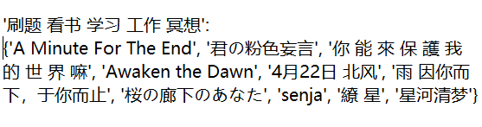
算法设计
Question Definition
0x00. What do we have?
About 600 music lists.
There are about 10 pieces of music in every music list.
About 4500 pieces of music in all.
0x01. Main Question:
Given a list of music, how to recommend another list of music?
{music_1, music_2, …, music_n} => {_music_1, _music_2, …, _music_m}

Slide 5
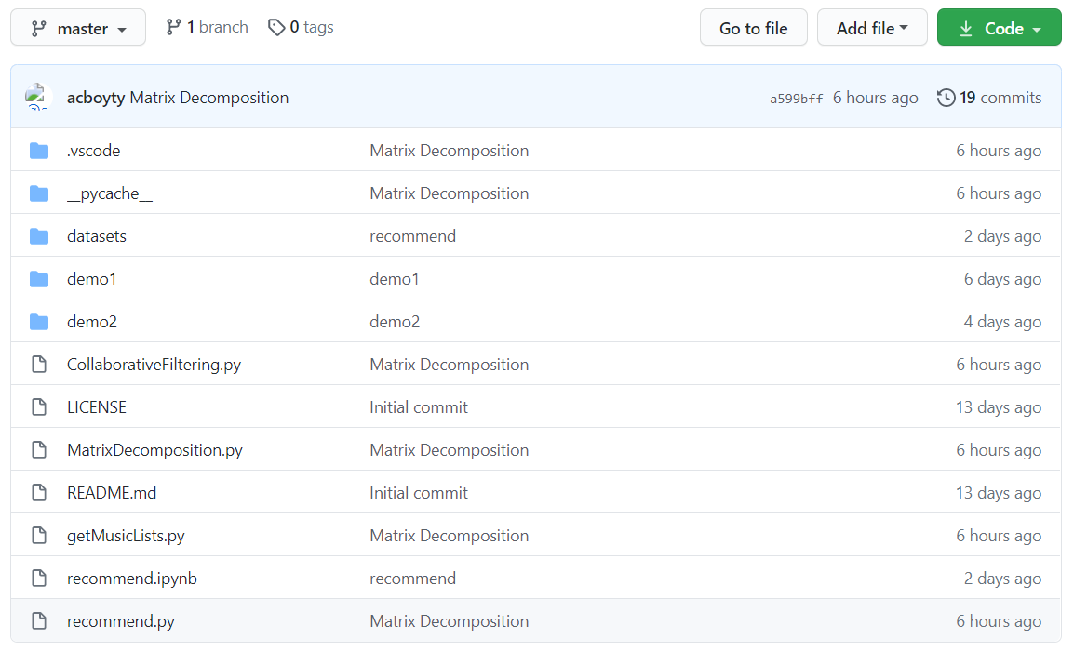
算法设计
Overall Algorithm
0x00. Our algorithm is mainly based on Collaborative Filtering(CF).
0x01. CF is composed of 3 methods: User-based CF(UserCF), Item-based CF(ItemCF), Latent Factor Model(LFM). We implement all of them.
All codes relating to algorithm are put on github: https://github.com/acboyty/MusicRecommendationAlgorithm

Slide 6
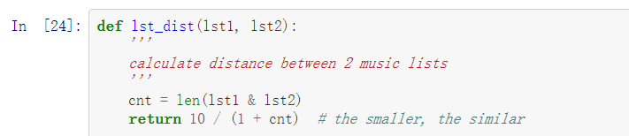
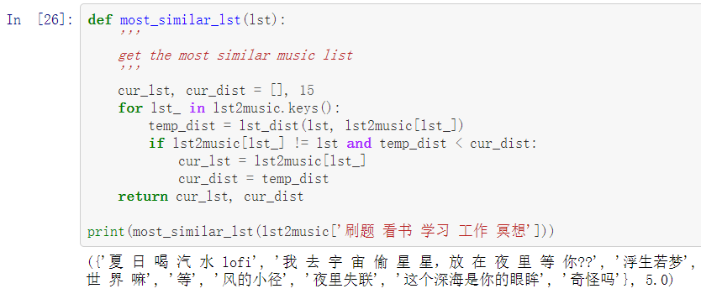
算法设计
User-based CF
0x00. One music list is composed of several pieces of music.
0x01. Similarity of 2 music lists
=> 10 / (1 + #same music)
=> The smaller, the more similar
0x02. Given a list of music, we calculate its distance(similarity) from all other music lists
0x03. Choose the most similar music list, and recommend the different music.

Slide 7
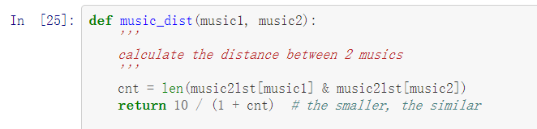
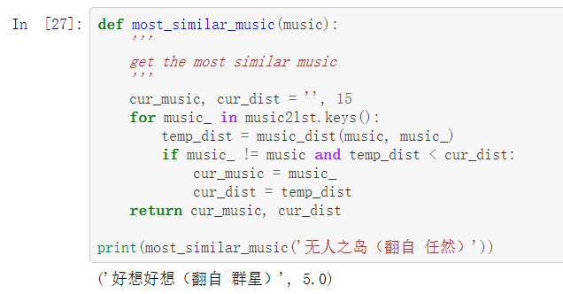
算法设计
Item-based CF
The ItemCF is similar to UserCF.
0x00. One music is included in several music lists.
0x01. Similarity of 2 pieces of music
=> 10 / (1 + #same music lists)
=> The smaller, the more similar
0x02. we calculate the distance(similarity) from all other music for all music in the given list.
0x03. Choose the most similar music for all music in the given list and recommend

Slide 8
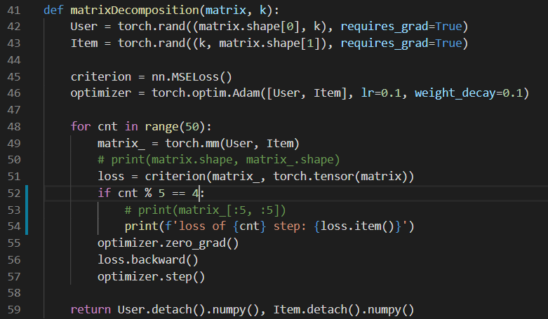
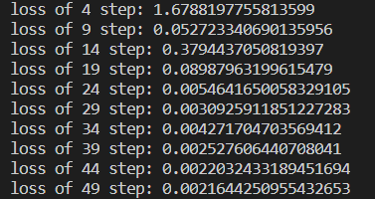
算法设计
Matrix Decomposition
Latent Factor M(LFM) is a special Collaborative Filtering method.
Matrix Decomposition is a representation of LFM.
0x00. We get the rating matrix R according to all the music lists.
(u, i) = 1 if (music i in the music list u) else 0
R is a 595 x 4631 matrix.
0x01. Decompose R into 2 matrix’s multiplication.
User x Item => R
User is a 595 x k matrix, Item is a k x 4631, k is of small range (50, 100).
0x02. Minimize the loss between User x Item and R, using PyTorch and Adam optimizer.
0x03. Predict the given user’s rating for all the music, and choose the highest.

Slide 9
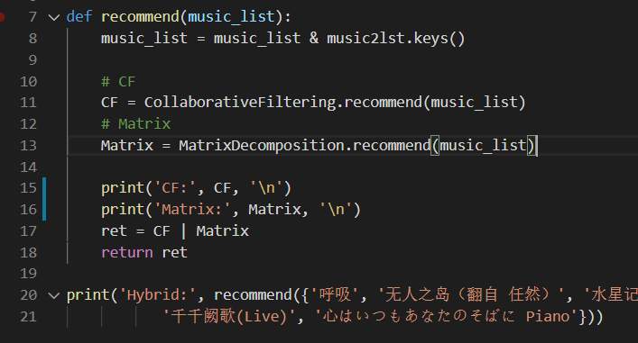
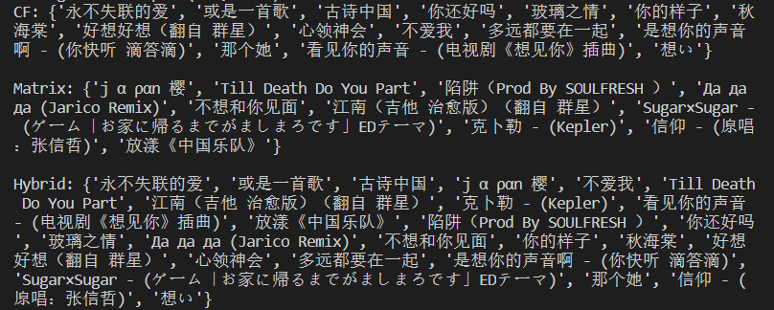
算法设计
Hybid
Use all three algorithms to recommend together.

Slide 10
感谢聆听
THANKS YOU
WE WILL DO A GREAT JOB !

